Slide 1
NAME : S.VENNELA ROLL NO. : 22VE1A05R0 SUBJECT : SOFTWARE ENGINEERING

Slide 2
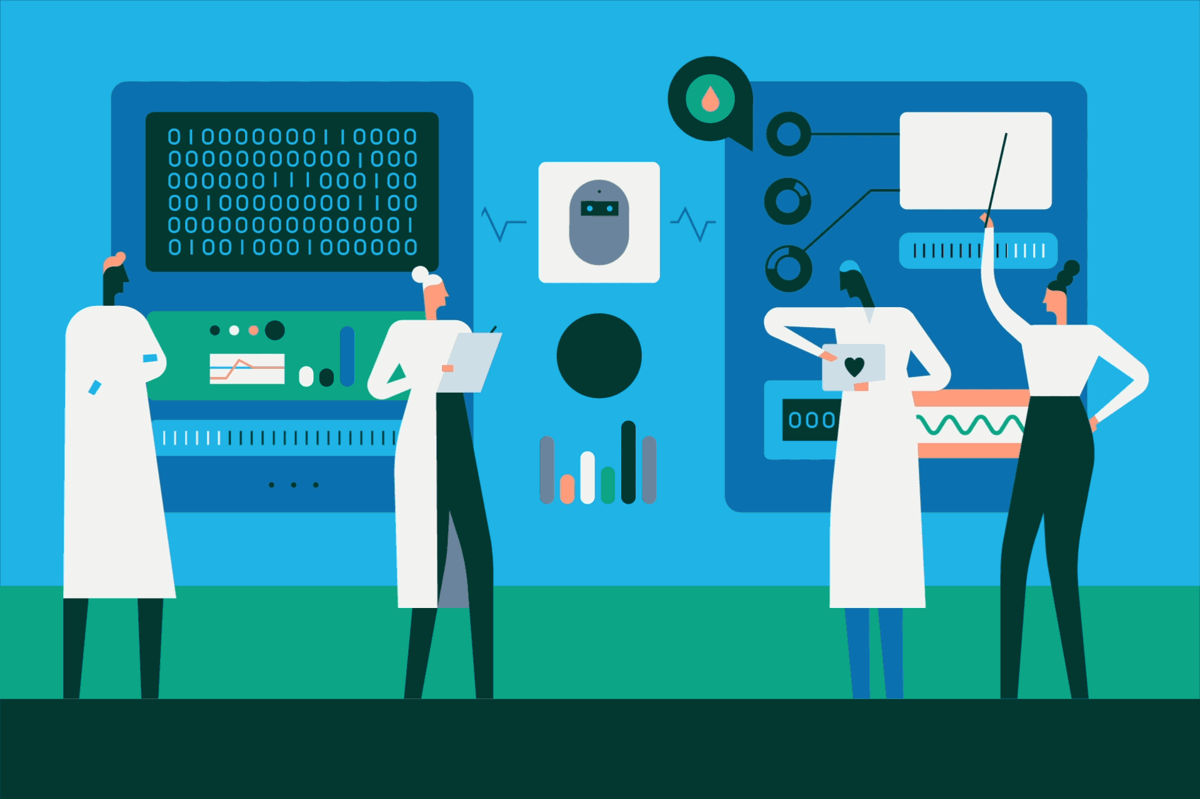
HAVE YOU EVER COME UP SEEING SUCH INSTANCE ?

Slide 3
INTRODUCTION TO ENTERPRISE APPLICATION INTEGRATION
Enterprise Application Integration (EAI) is like connecting different parts of a big company's computer systems so they can all talk to each other smoothly. Imagine a company where each department has its own computer system for things like accounting, sales, and inventory. These systems often use different languages or formats to store information. EAI is like a translator that helps these systems understand each other and share information seamlessly. It ensures that data can flow between different applications without any hiccups, making the whole company work more efficiently.

Slide 4
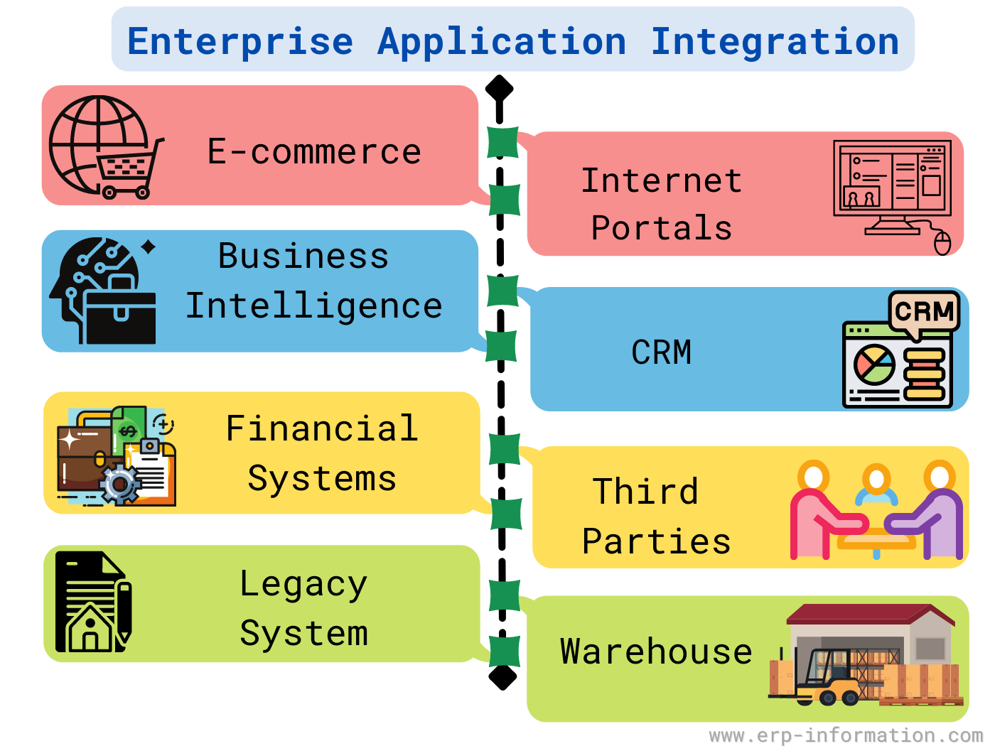
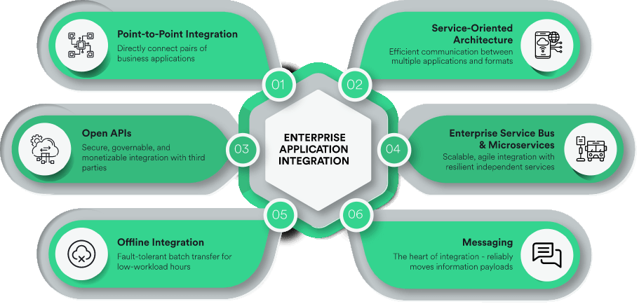
ENTERPRISE APPLICATION INTEGRATION

Slide 5
GOALS OF ENTERPRISE APPLICATION INTEGRATION
Data integration. The EAI platform integrates data to facilitate communications and improve data quality. As part of this process, the platform removes duplicate data, formats the data where necessary, and transforms the data in other ways to ensure consistency between applications and to reduce errors and other data issues. The platform also synchronizes data stores and keeps them up to date with changes.
Workflow integration. An EAI platform often includes tools for enabling the applications and services to work together. This can increase productivity by making common tasks easier to perform. For example, onboarding an employee might require human resources to update payroll systems, personnel records, floor plans, door access controls and IT resources. With EAI, these different tasks can be performed as a single workflow instead of separate operations.
Interface integration. An EAI platform provides a single interface that enables users to connect with the applications, services, databases and other systems integrated into the platform. In this way, users don't have to negotiate the individual interfaces available to each system. The challenge with a single interface, however, is that even a minor change to an application or service can potentially impact the interface's functionality.

Slide 6
TYPES OF ENTERPRISE APPLICATION INTEGRATION
Point-to-point integration. This is the simplest form of EAI. In it, data is taken from one system, reformatted if necessary, and then ingested by the next system. This type of integration is relatively simple to implement for small workflows and a few applications. However, the platform can quickly grow large and difficult to manage as more applications are added.
Middleware integration. The EAI platform is implemented as an intermediary layer that connects the applications, data and users. Middleware platforms take different approaches to delivering EAI services. For example, a platform might be based on a bus design or hub-and-spoke design, or it might use a technology such as MOM, application server middleware or transaction processing monitors.
Hub-and-spoke integration. This approach uses a central component (hub) to facilitate data communications between the participating applications. The hub reformats the data and keeps workflows moving in the event of an application slowdown. Hub-and-spoke integration is faster and more reliable than point-to-point but is more complex to implement and maintain.

Slide 7
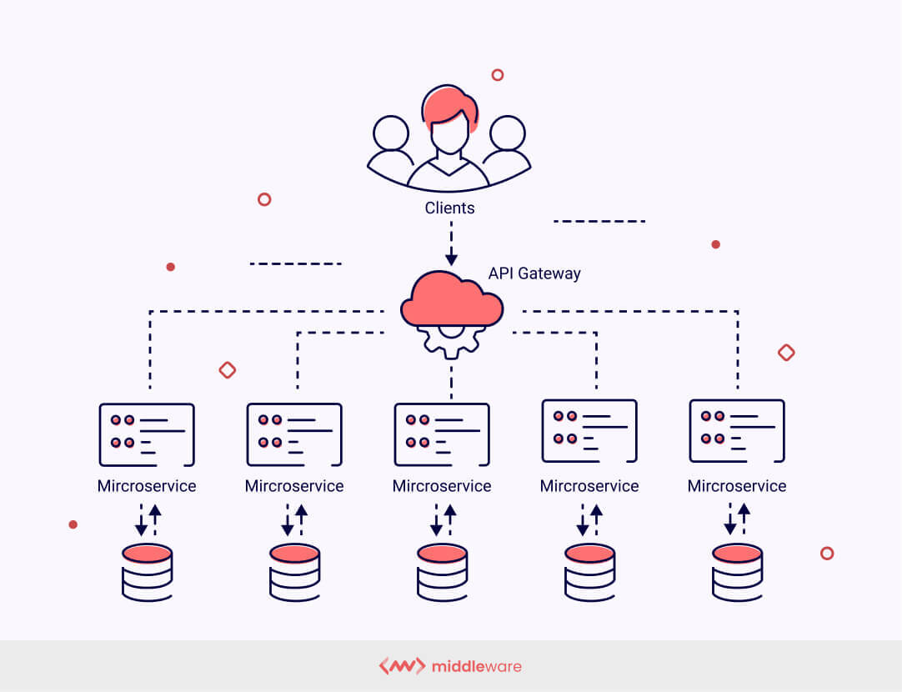
TYPES OF ENTERPRISE APPLICATION INTEGRATION
Bus integration. Also called an ESB, this approach is an evolution of hub-and-spoke design. All participating applications use a set of standards to send and receive data or workflows through the central bus. This allows for quick and easy integration but requires more work during the planning and implementation phases.
Microservices. An EAI platform can be implemented through microservices, which are small, lightweight applications that each serve a specific purpose. The microservices can be created as serverless functions or as dedicated apps. To integrate with the various systems, they use APIs and industry-standard protocols. Microservices can also be easily deployed as cloud workloads

Slide 8
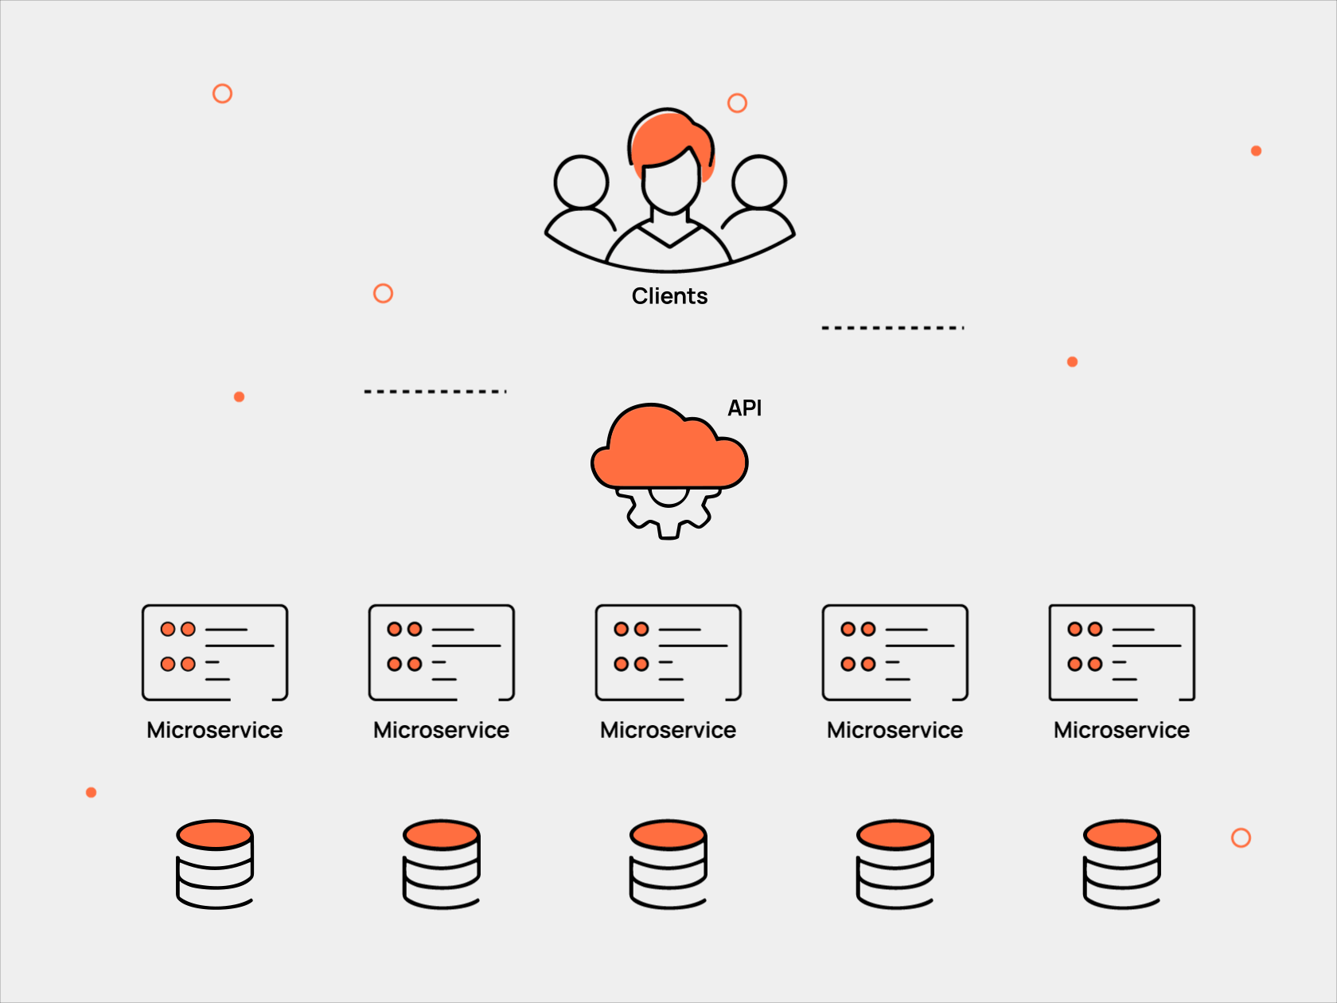
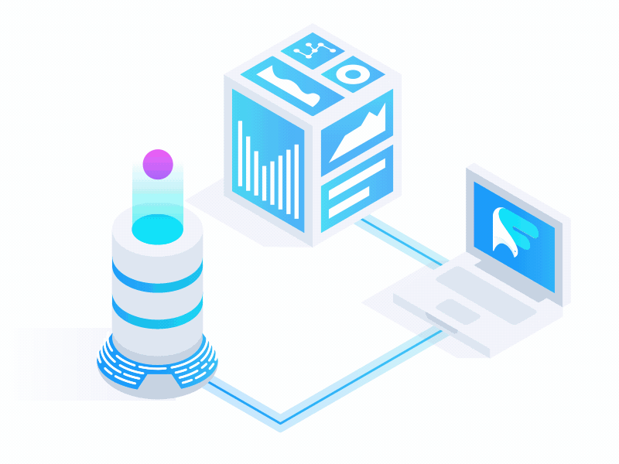

Slide 9



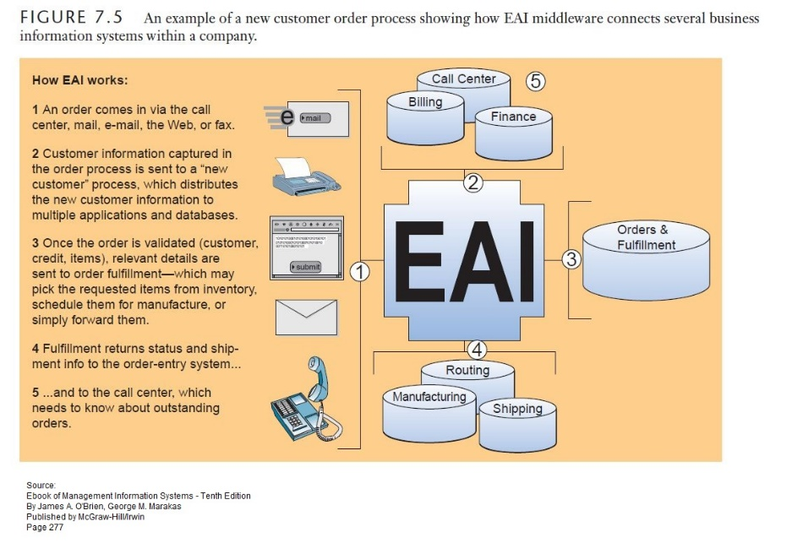
ENTERPRISE APPLICATION INTEGRATION
Data Transformation: One of the primary functions of EAI is to ensure that data from various sources can be harmonized and understood by different applications
Message Queuing and Routing: EAI solutions typically incorporate message queuing and routing mechanisms to manage the flow of data between different systems. Message queues serve as temporary storage for data messages, ensuring reliable delivery and asynchronous communication between applications.
Security and Governance :Ensuring the Security,compliance ,and governance of integrated systems is a critical aspect of EAI.

Slide 10

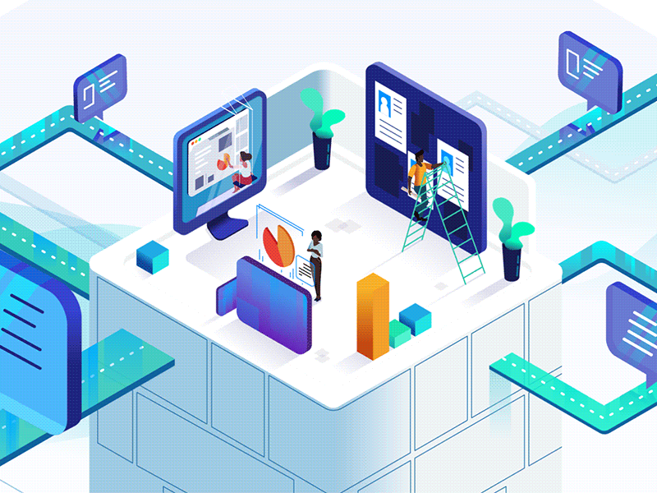
ENTERPRISE APPLICATION INTEGRATION

Slide 11
ADVANTAGES OF ENTERPRISE APPLICATION INTEGRATION
Reduced data silos. By integrating data across systems, an EAI platform reduces or eliminates data silos. The data is accessible by all systems and users, who now have a unified view of the data no matter what tasks they're trying to perform.
Improved data quality. Data that is integrated through an EAI platform is more accurate and consistent. This improves data quality and makes it easier to understand, share and collaborate on the data. The improved data quality also leads to better analytics and more effective decision-making.
Streamlined operations. An EAI platform can integrate an organization's key applications and services, resulting in greater operational efficiency and more streamlined business processes. To this end, the platform simplifies workflows, while reducing the time and effort it takes to carry out tasks.
Improved customer experience. An EAI platform provides a unified view of the data that is accurate, consistent and up to date. The organization's personnel, as well as its customers, have the information they need when they need it, helping to streamline and expedite processes such as sales inquiries, support calls, customer resource management, self-service account updates and other tasks.
Reduced costs. Because an EAI platform streamlines operations, business processes are more efficient and employees are more productive, both of which can help reduce overall costs. The increased productivity can also lead to new revenue sources because employees have more time to focus on new initiatives. In addition, the ability to integrate legacy systems into the platform can help reduce IT expenditures.

Slide 12
DISADVANTAGES OF ENTERPRISE APPLICATION INTEGRATION
Complexity. Applications, services and database systems often vary substantially. Not only can the underlying technologies differ, but also the way in which data is stored, formatted, delivered and presented. Trying to integrate these systems into a unified operation is no small task. It takes time, resources and a fair amount of expertise.
Legacy systems. Integrating legacy systems with other applications and services can be difficult. Older systems are often incompatible with modern applications or even other legacy systems. The older the legacy systems and greater their number, the more challenges they present.
Scalability. Even if all the applications and services can be seamlessly integrated with each other, an EAI platform might still run into problems as data volumes grow and the number of transactions increases. If an organization relies primarily on cloud services, scalability is usually not much of an issue (except in terms of costs). For on-premises systems, however, an EAI platform must be agile enough to accommodate changes in workload and data patterns, otherwise the EAI platform might suffer serious performance degradation.
Security risks. When implementing an EAI platform, an organization must ensure that the platform includes effective security and privacy protections and adheres to all applicable regulations. Failing to exercise due diligence in any aspect of the platform's implementation can leave serious holes in those protections. As an EAI platform becomes more complex, so too can security and privacy management.

Slide 13


